Slide 1

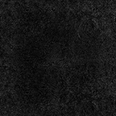
The Process of Creating 7nm Transistors for CPUs
Utsav Singha

Slide 2
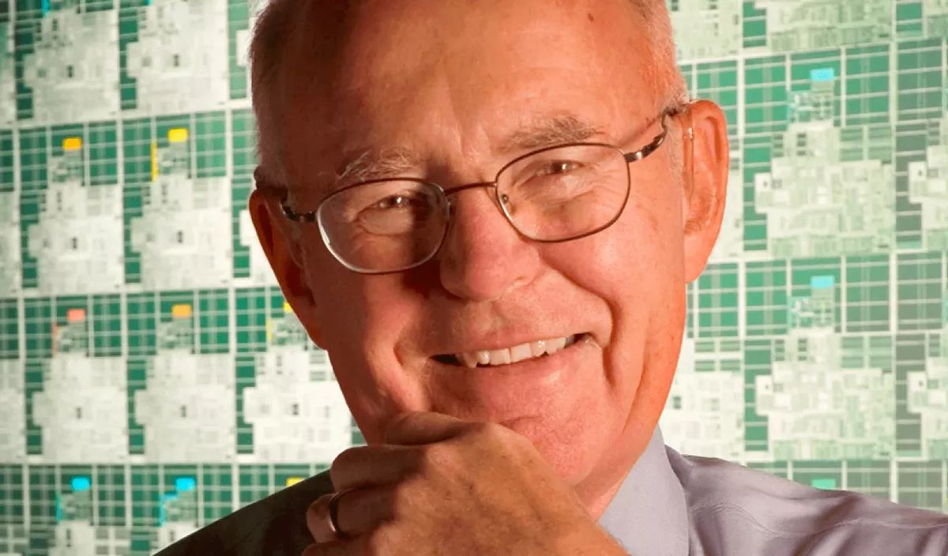
Introduction
Moore’s Law
“The observation that the number of transistors on an integrated circuit will double every two years with minimal rise in cost” (1)
Through the process of lithography using a laser to etch patterns in silicon, engineers were able to keep up with Moore’s prediction.
This Photo by Unknown Author is licensed under CC BY-NC-ND
Roser, M., Ritchie, H., & Mathieu, E. (2024, February 1). What is Moore’s law? Our World in Data. https://ourworldindata.org/moores-law

Slide 3
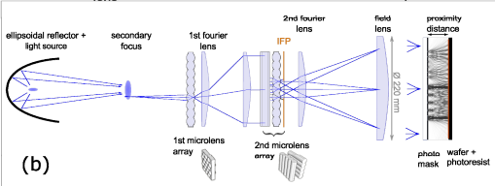
Lithography Roadblock
Originally engineers used a mercury vapor lamp to create a blue light with a wavelength of 436nm and could etch features up to 1 micron. (2)
Switched to UV light with a wavelength of 365nm which could etch up to 220nm.
In 1980, ASML developed Kr:F lasers and later ArF lasers which could produce DUV light of 280nm and 193nm and could etch 80nm and 38nm.
Current limitation as naturally occurring UV light occurs around 100-400nm (3)
(2) All about light and lasers in lithography. ASML. (n.d.). https://www.asml.com/en/technology/lithography-principles/light-and-lasers
(3) World Health Organization. (n.d.). Radiation: Ultraviolet (UV) radiation. World Health Organization. https://www.who.int/news-room/questions-and-answers/item/radiation-ultraviolet-(uv)#:~:text=The%20UV%20region%20covers%20the,(100-280%20nm).

Slide 4
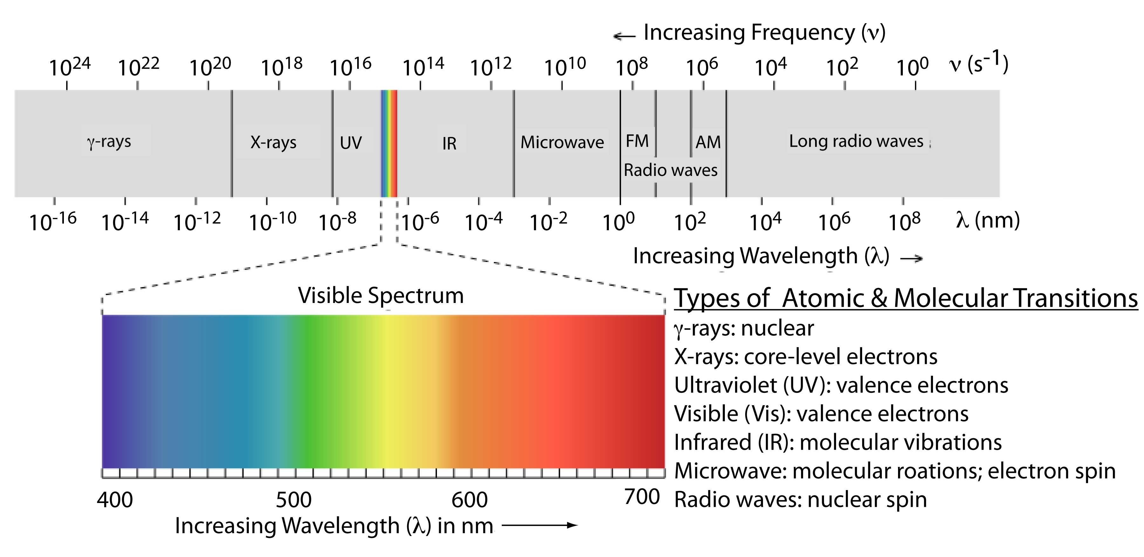
DUV roughly 193nm
EUV roughly 15.5nm
This Photo by Unknown Author is licensed under CC BY-SA-NC

Slide 5
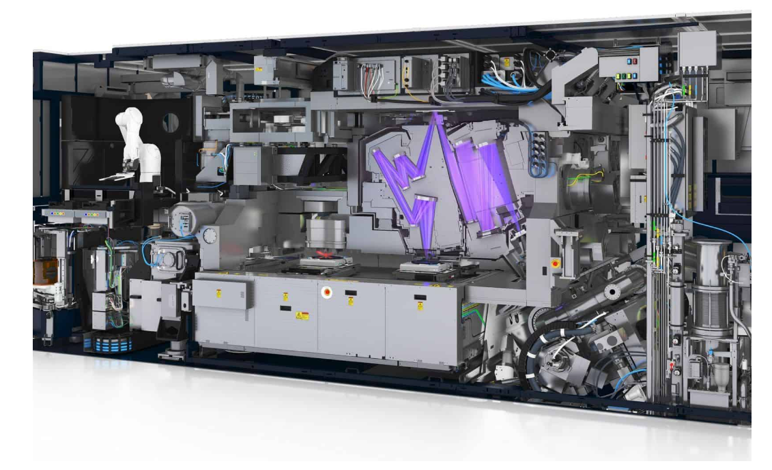
EUV Lithography
In 1998 ASML started development on a prototype extreme ultraviolet lithography system along with many others. (4)
In 2008 development was complete and the first EUV test chips were made.
First lithography machine shipped out in 2010 to Samsung.
ASML EUV Lithography Machine
(4) Making EUV: From lab to fab. ASML. (n.d.-b). https://www.asml.com/en/news/stories/2022/making-euv-lab-to-fab

Slide 6
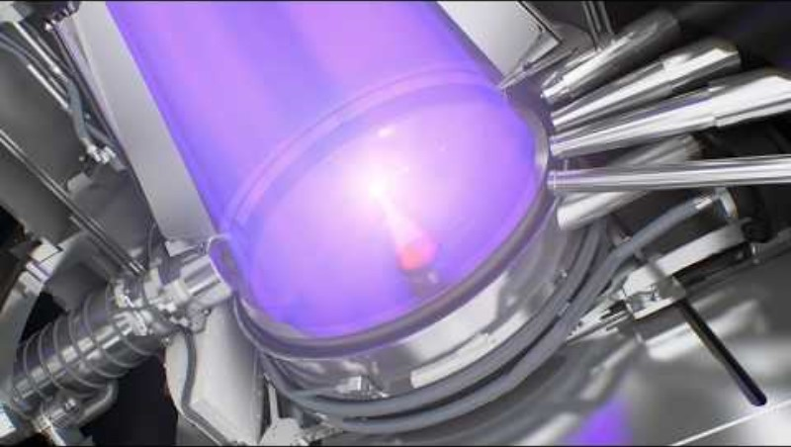
How EUV Was Generated
Shoot liquid tin droplets at 275 bar, then blast it with an amplified CO2 laser twice (5)
The first blast flattens the tin
The second vaporizes it to over 40x hotter than the sun, generating the EUV light
1 bar is .9986923 atm
(5) ASML EUV lithography systems. ASML. (n.d.-b). https://www.asml.com/en/products/euv-lithography-systems

Slide 7
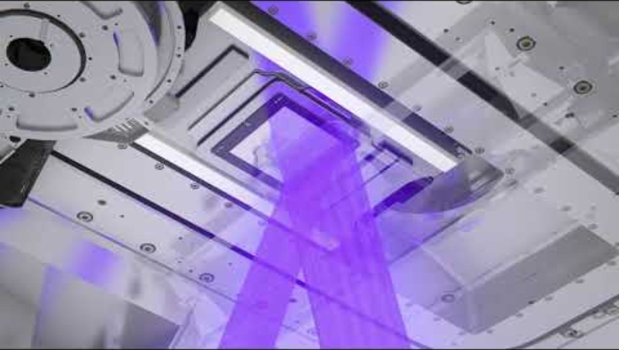
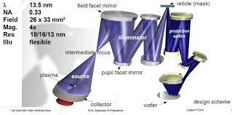
Where The EUV Light Goes
(6) LaPedus, M. (2017, April 17). Why EUV is so difficult. Semiconductor Engineering. https://semiengineering.com/why-euv-is-so-difficult/

Slide 8
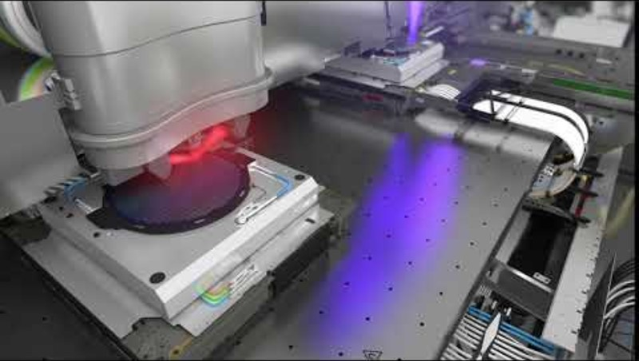
The Etching Process
The reflected EUV rays are finally etched onto the silicon wafer. (7)
The wafer is adjusted to within a quarter of a nanometer with each EUV exposure.
The plate moves around with electromagnets
(7) 6 crucial steps in semiconductor manufacturing. ASML. (n.d.-a). https://www.asml.com/en/news/stories/2021/semiconductor-manufacturing-process-steps

Slide 9
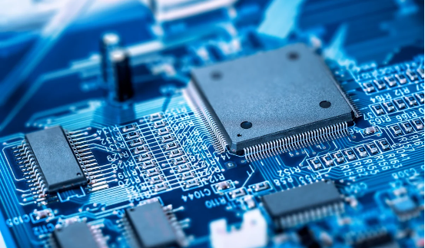
Ionization
Etched silicon wafer is bombarded with ions which tunes the electrical properties of the silicon wafer (7)
This is the process that creates the transistors, resulting in billions of transistors in the modern CPU chip.
Diamond tooth saw cuts wafer into separate “dies”
Which is then set on substrate and uses robots to add metal foils to complete the circuitry.

Slide 10

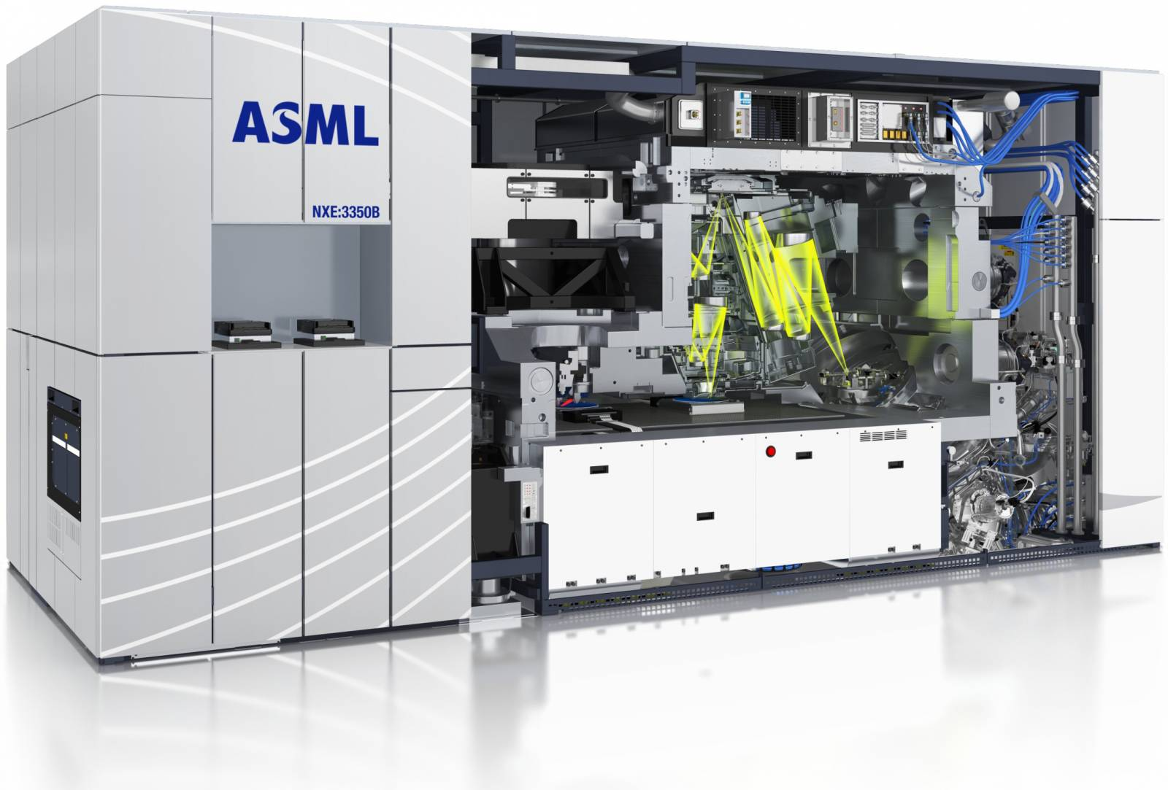

Closing Notes
Although ASML is the only manufacturer of these machine, they do not directly create the CPUs.
TSMC
Samsung
Intel
This Photo by Unknown Author is licensed under CC BY-SA
This Photo by Unknown Author is licensed under CC BY-ND

Slide 11
Sources
6 crucial steps in semiconductor manufacturing. ASML. (n.d.-a). https://www.asml.com/en/news/stories/2021/semiconductor-manufacturing-process-steps
All about light and lasers in lithography. ASML. (n.d.). https://www.asml.com/en/technology/lithography-principles/light-and-lasers
ASML EUV lithography systems. ASML. (n.d.-b). https://www.asml.com/en/products/euv-lithography-systems
LaPedus, M. (2017, April 17). Why EUV is so difficult. Semiconductor Engineering. https://semiengineering.com/why-euv-is-so-difficult/
Making EUV: From lab to fab. ASML. (n.d.-b). https://www.asml.com/en/news/stories/2022/making-euv-lab-to-fab
Roser, M., Ritchie, H., & Mathieu, E. (2024, February 1). What is Moore’s law? Our World in Data. https://ourworldindata.org/moores-law
World Health Organization. (n.d.). Radiation: Ultraviolet (UV) radiation. World Health Organization. https://www.who.int/news-room/questions-and-answers/item/radiation-ultraviolet-(uv)#:~:text=The%20UV%20region%20covers%20the,(100-280%20nm). [Original source: https://studycrumb.com/alphabetizer]

